Slide 1


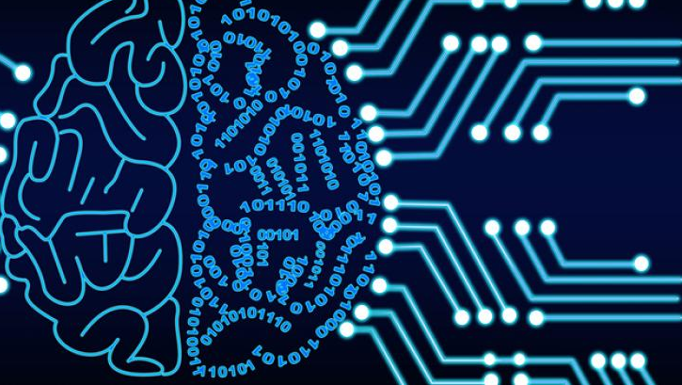
INTRODUCTION TO ARTIFICIAL INTELLIGENCE
CS-461 CHAPTER #1
Instructor: Saeeda Kanwal

Slide 2
What Content are you expecting from this course?

Slide 3
Course Catalog
1: Introduction (Agents) 8: Learning
2: Uninformed Search
3: Informed Search
4: CSPs
5: Adversarial Search
6: Knowledge based agents
7: Uncertainty

Slide 4
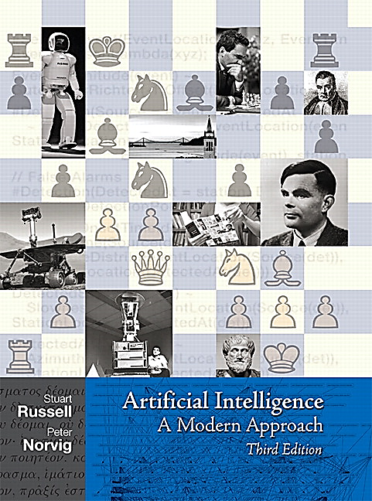
Textbook
Artificial intelligence: A modern approach (3rd edition), Stuart Russell and Peter Norvig

Slide 5
MARKS DISTRIBUTION
Assignments 20
Mid exams 15
Project 10
Class Participation 15
Final 40

Slide 6
AGENDA
Introduction to artificial intelligence?
A very brief history of AI
Foundations of AI
AI state of Art
How much progress has been made in different aspects of AI

Slide 7

What makes human intelligent?
Learn
Learning and Adapting by Experiences from Surroundings
Think
Problem solving
(Game theory)
Make Decisions
YES/NO

Slide 8
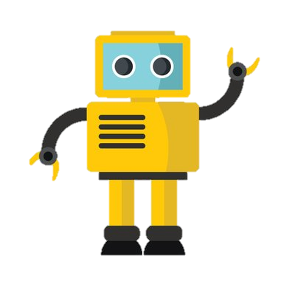
I can show human like intelligence
Think
Make Decisions

Slide 9

Human intelligence

Slide 10
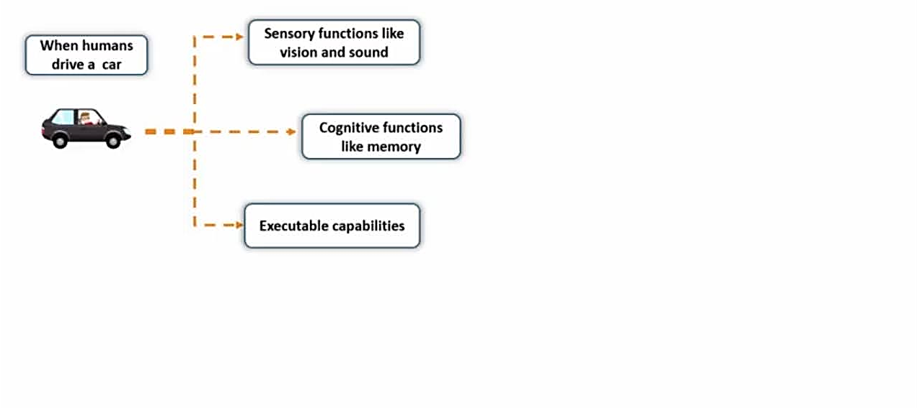

Slide 11
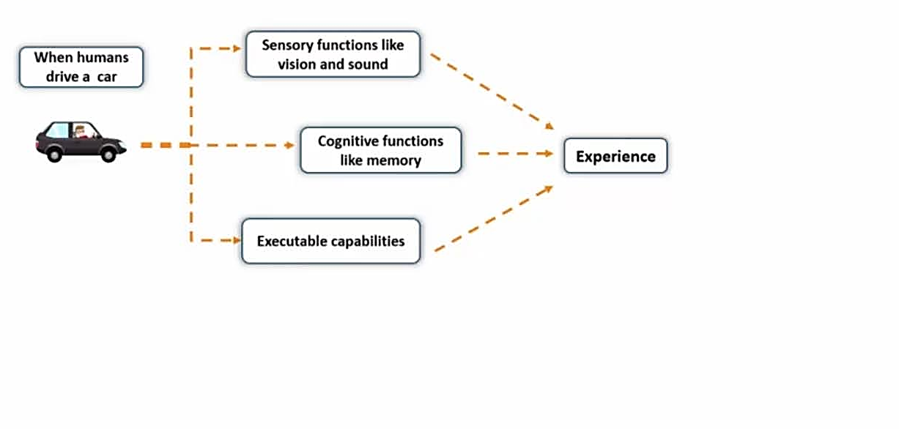

Slide 12
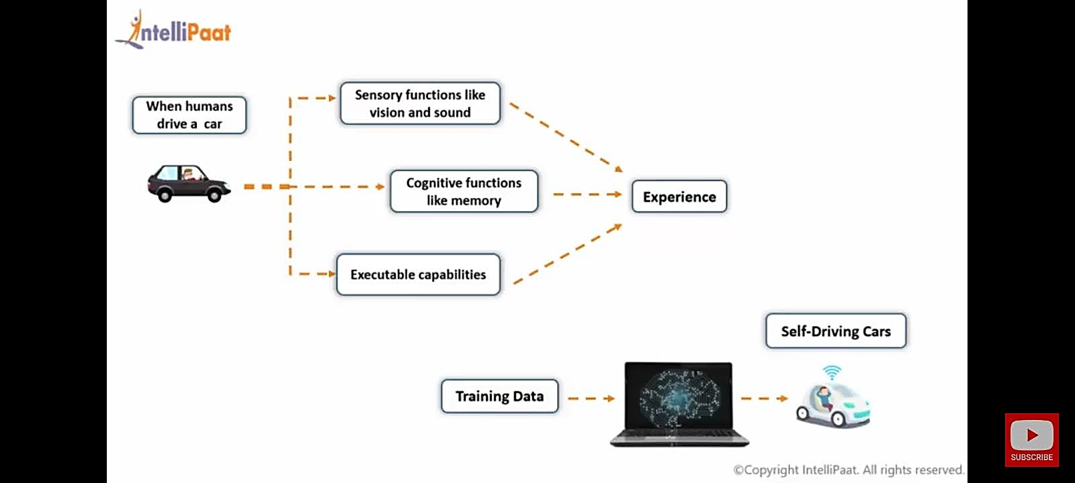

Slide 13
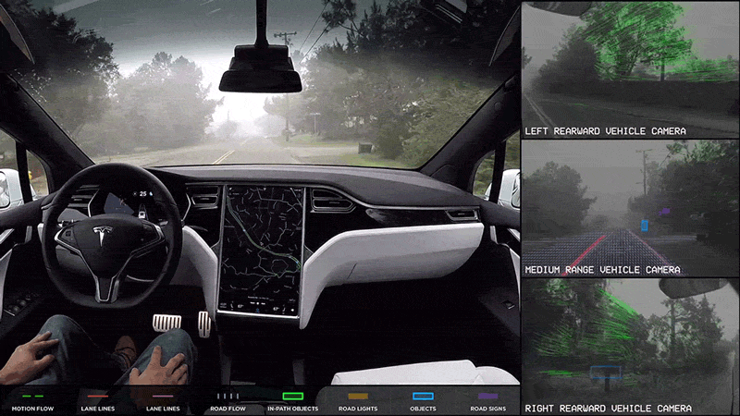

Slide 14
History of AI
1950: Turing
Turing's "Computing Machinery and Intelligence“
1956: birth of AI
Dartmouth meeting: "Artificial Intelligence“ name adopted
1950s: initial promise
Early AI programs, including
Samuel's checkers program
Newell & Simon's Logic Theory
1986-- Rise of machine learning
Neural networks return to popularity
Major advances in machine learning algorithms and applications
1990-- Role of uncertainty
Bayesian networks as a knowledge representation framework
1995-- AI as Science
Integration of learning, reasoning, knowledge representation
AI methods used in vision, language, data mining, etc

Slide 15
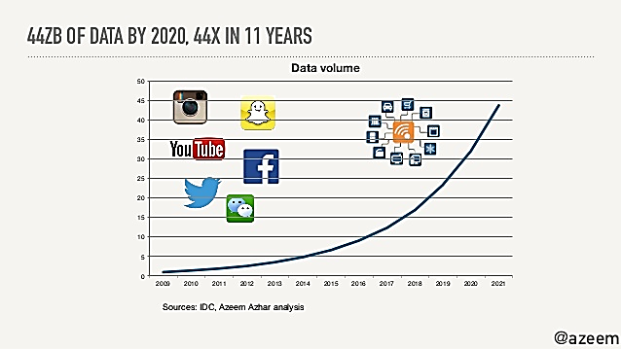

WHY AI???

Slide 16
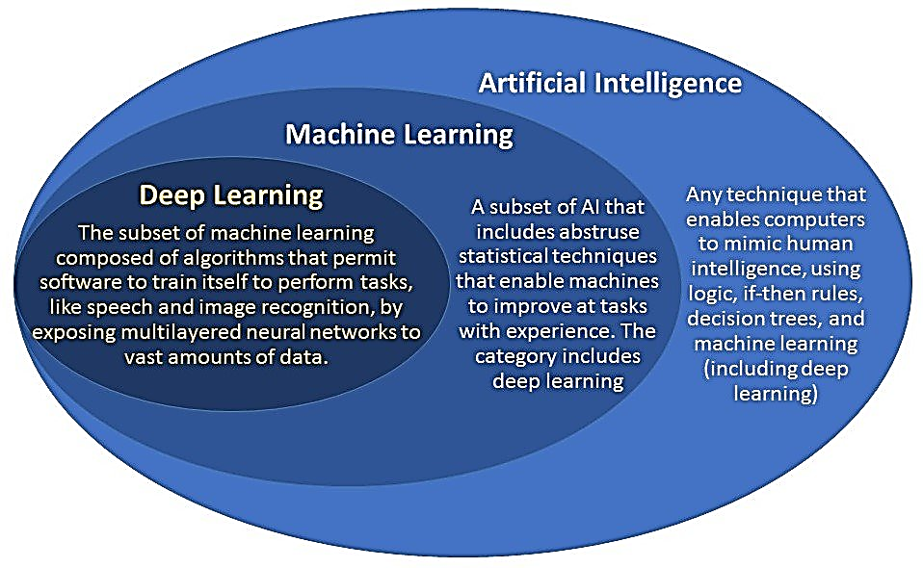
Difference

Slide 17
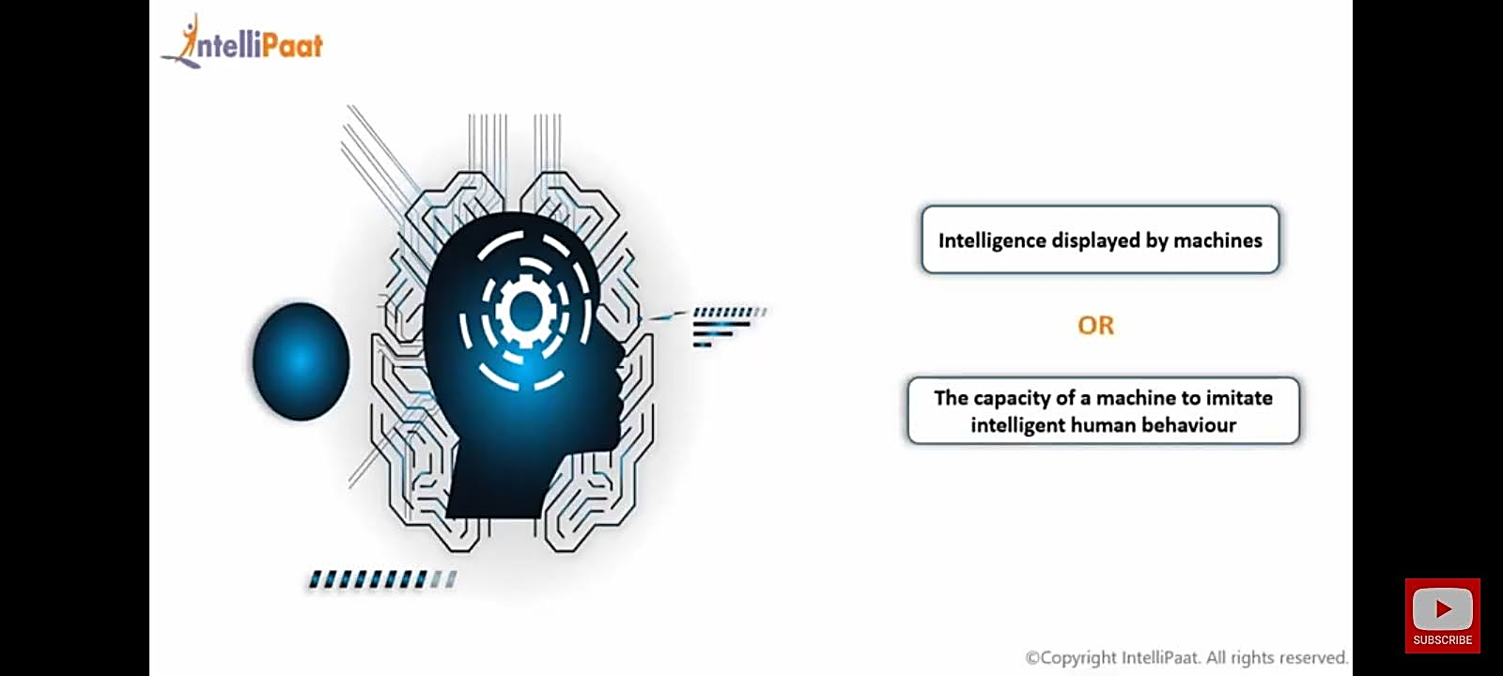
Artificial Intelligence

Slide 18
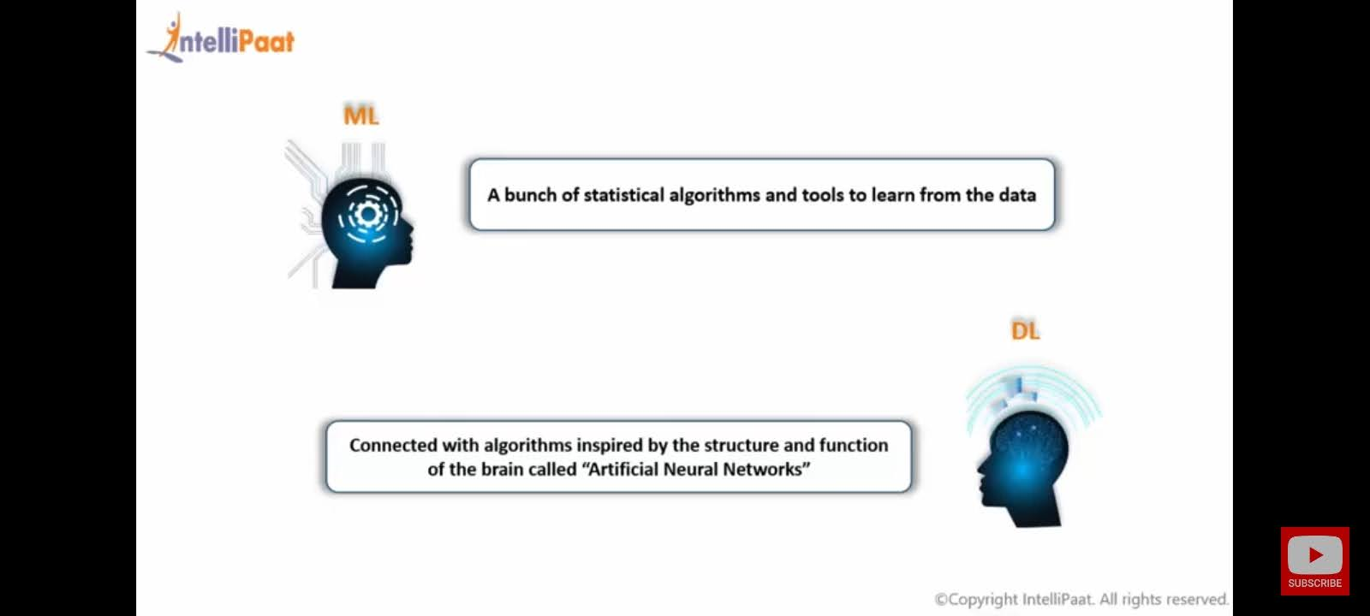
ML and DL

Slide 19
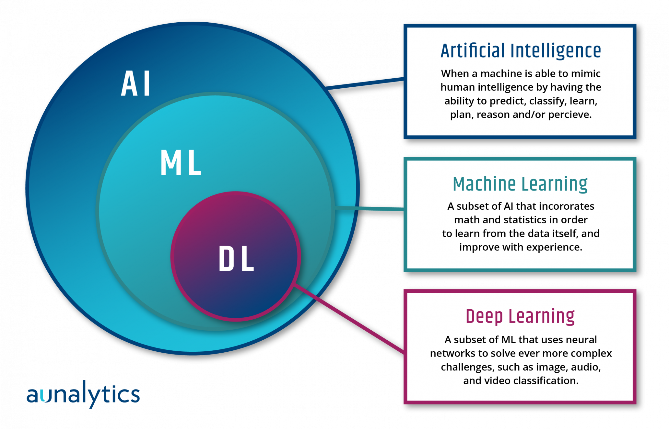

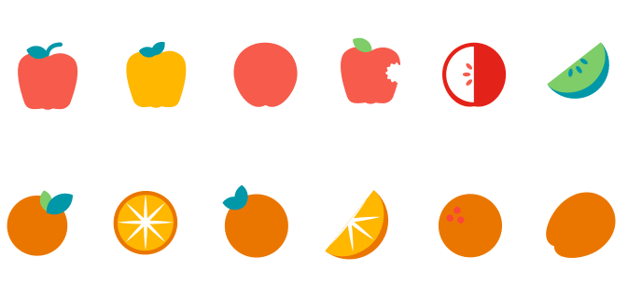
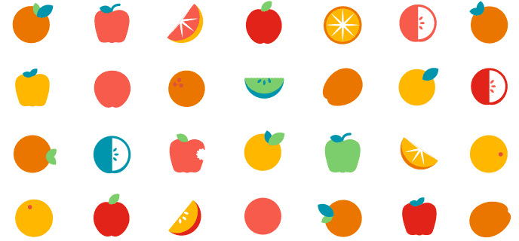

Slide 20
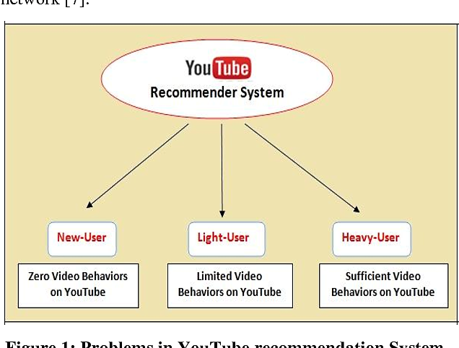
ML Application

Slide 21
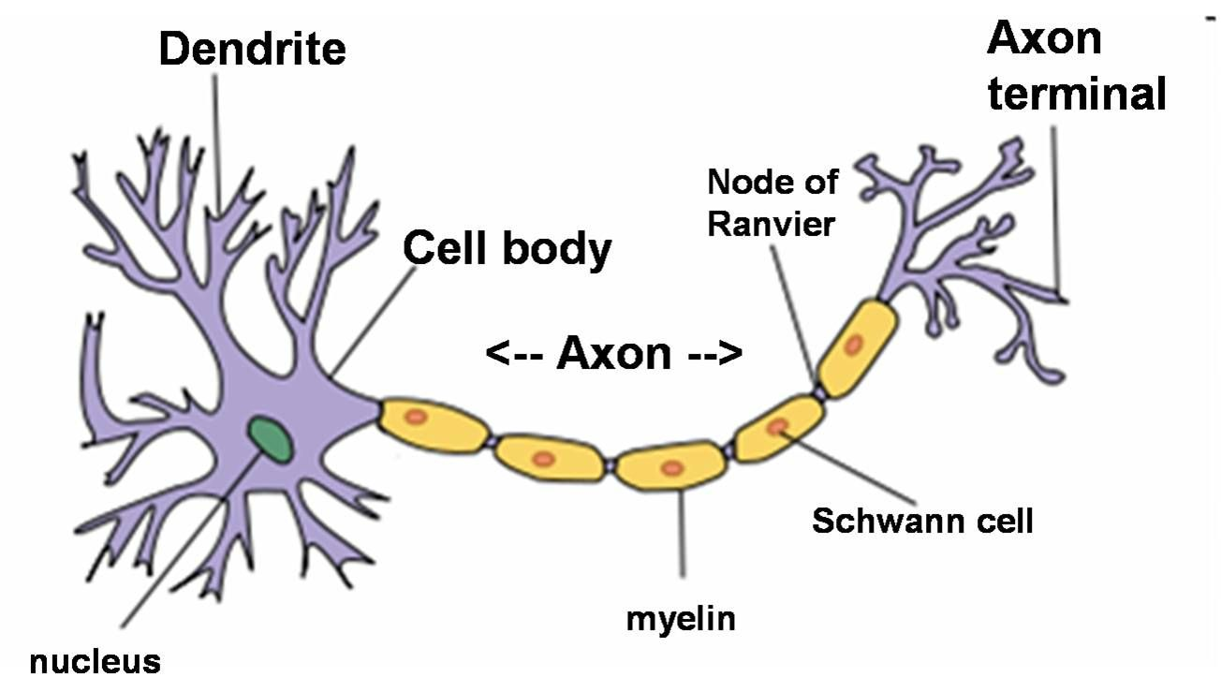
DL (BIOLOGICAL NEURON)

Slide 22
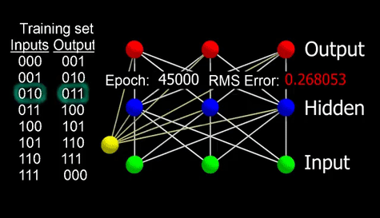

Artificial Neuron

Slide 23
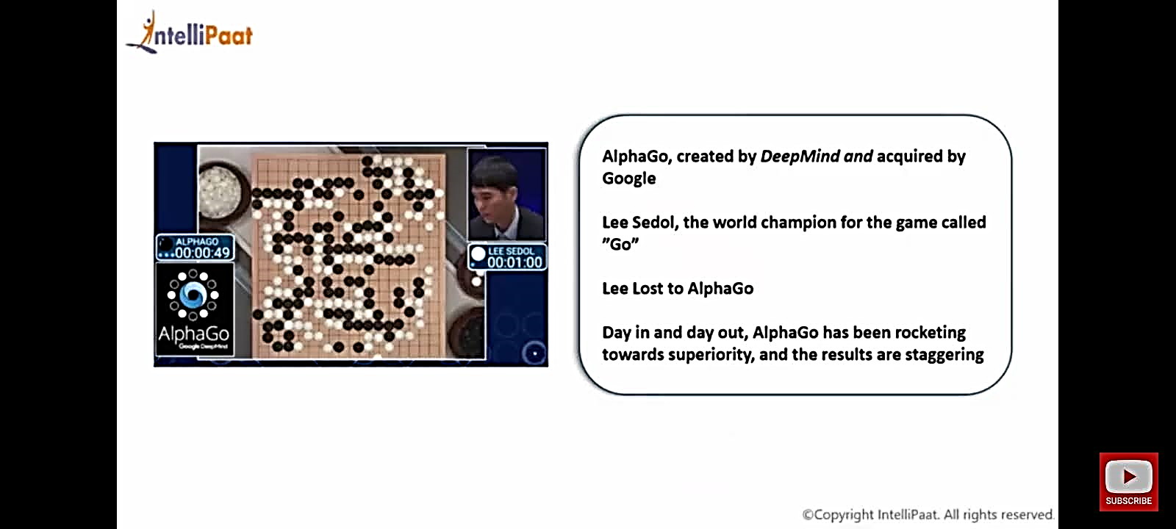
DL Application

Slide 24
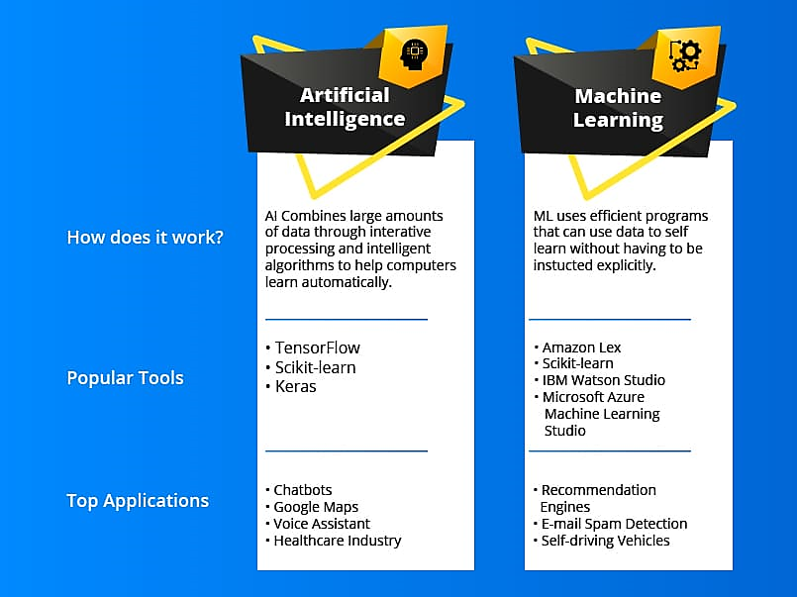

Slide 25
State of the Art
Deep Blue defeated the reigning world chess champion Garry Kasparov in 1997
AI program proved a mathematical conjecture (Robbins conjecture) unsolved for decades
NASA's on-board autonomous planning program controlled the scheduling of operations for a spacecraft
Speech recognition: A traveler calling United Airlines to book a flight can have the entire conversation guided by an automated speech recognition and dialog management system.
Face recognition software available in consumer cameras

Slide 26
What is Artificial Intelligence?
It is the science and engineering of making intelligent machines, especially intelligent computer programs. It is related to the similar task of using computers to understand human intelligence, but AI does not have to confine itself to methods that are biologically observable.
Views of AI fall into four categories:
Thinking Humanly
Acting Humanly
Thinking Rationally
Acting Rationally

Slide 27
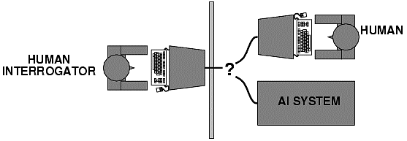
Acting humanly: Turing test
Alan Turing (1950) "Computing machinery and intelligence“
"Can machines think?" → "Can machines behave intelligently?“
Operational test for intelligent behavior: the Imitation Game
It was designed to provide a satisfactory operational definition of intelligence. A computer passes the test if a human interrogator, after posing some written questions, cannot tell whether the written responses come from a person or from a computer.

Slide 28
Thinking humanly: The cognitive modeling approach
Requires detailed matching of computer behavior and timing to detailed measurements of human subjects gathered in psychological experiments.
Cognitive Science approach
Try to get “inside” our minds
E.g., conduct experiments with people to try to “reverse-engineer” how we reason, learning, remember, predict
So, we need to get inside the actual workings of human minds.
There are three ways to do this:
through introspection—trying to catch our own thoughts as they go by;
through psychological experiments—observing a person in action;
and through brain imaging—observing the brain in action.

Slide 29
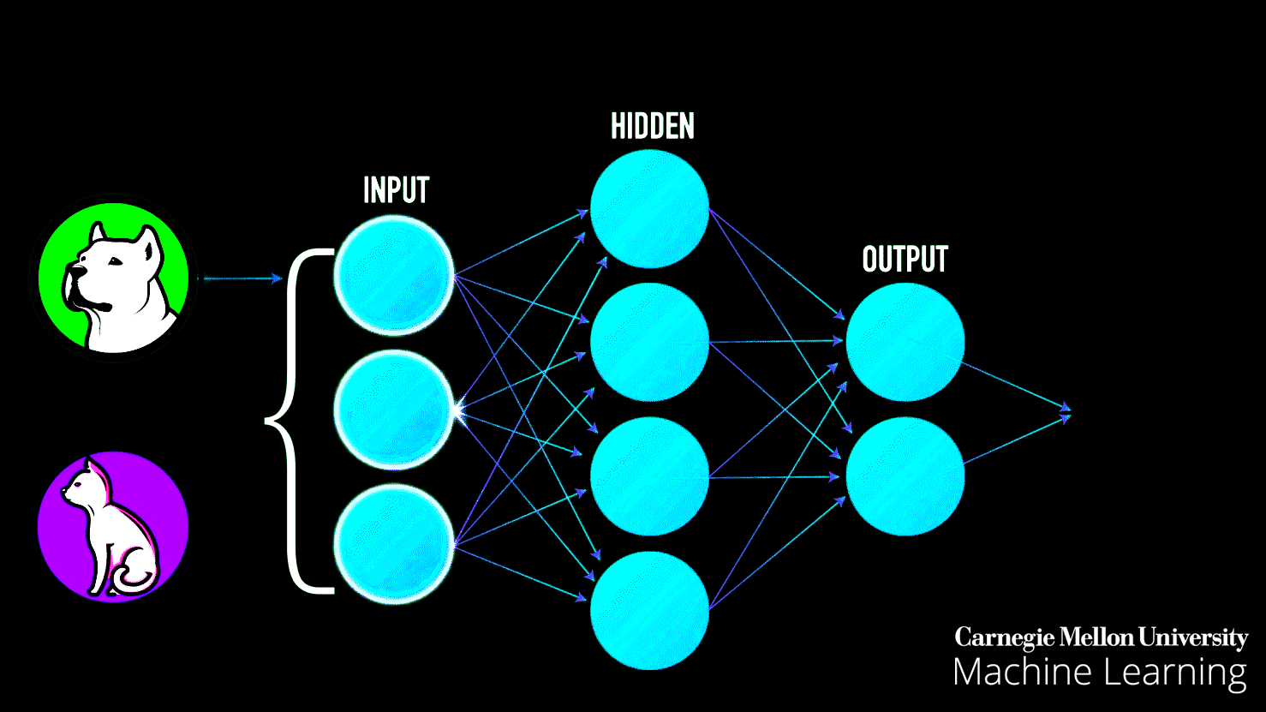

Slide 30
Thinking Rationally: Laws of Thought
Formalize “correct” reasoning using a mathematical model (e.g. of deductive reasoning/logical conclusion).
Logics Program: Encode knowledge in formal logical statements and use mathematical deduction to perform reasoning:
Problems:
-Formalizing common sense knowledge is difficult.
-General deductive inference is computationally
intractable.

Slide 31
Acting Rationally: The Rational Agent
An agent is an entity that perceives its environment and is able to execute actions to change it.
Agents have inherent goals that they want to achieve (e.g. survive, reproduce).
A rational agent acts in a way to maximize the achievement of its goals.
True maximization of goals requires omniscience and unlimited computational abilities.
Limited rationality involves maximizing goals within the computational and other resources available.

Slide 32
Foundations of Artificial Intelligence
Philosophy Logic, methods of reasoning, mind as physical system, foundations of learning, language , rationality.
Mathematics formal representation and proof, algorithms , computation.
Probability/statistics modeling uncertainty, learning from data
Economics utility, decision theory, rational economic agents
Neuroscience neurons as information processing units.
Computer building fast computers engineering
Psychology how do people behave, perceive, process cognitive science information, represent knowledge.
Linguistics knowledge representation, grammars

Slide 33
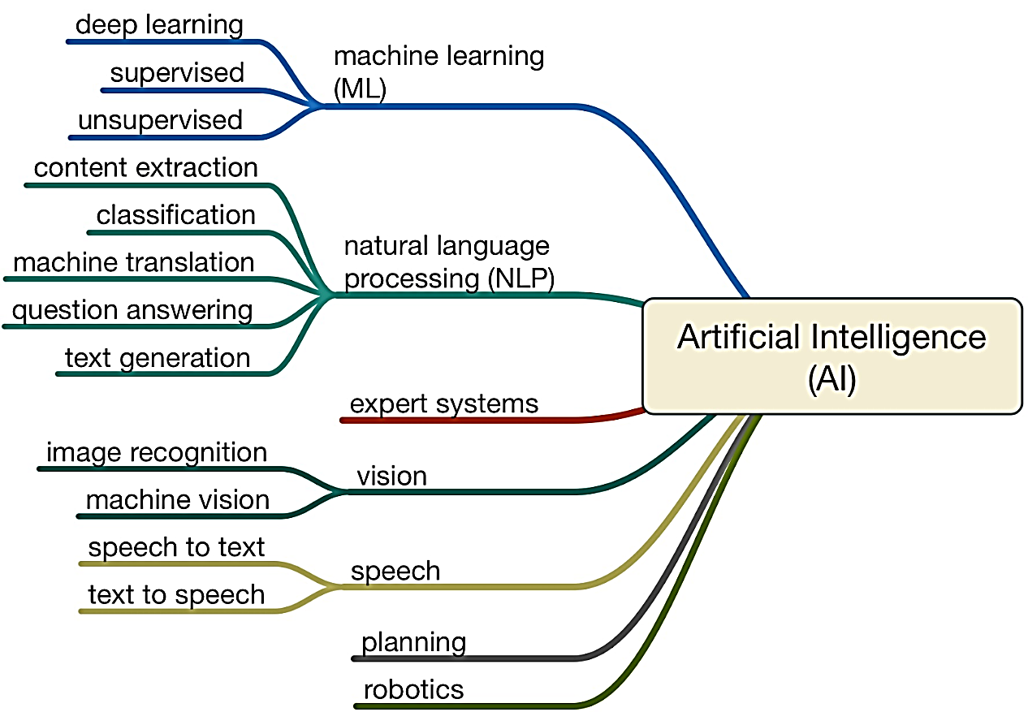
AI Umbrella

Slide 34
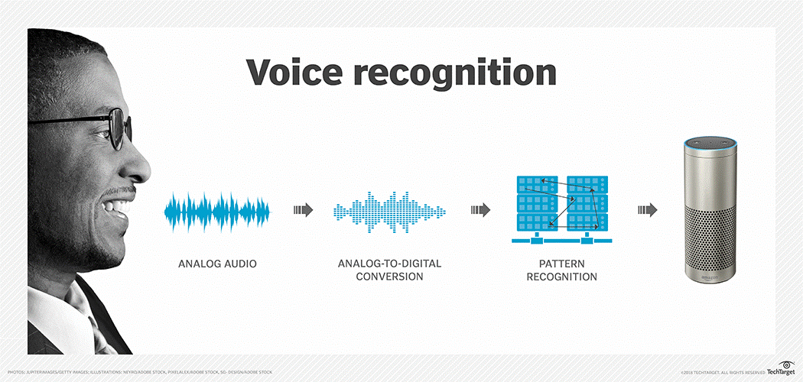
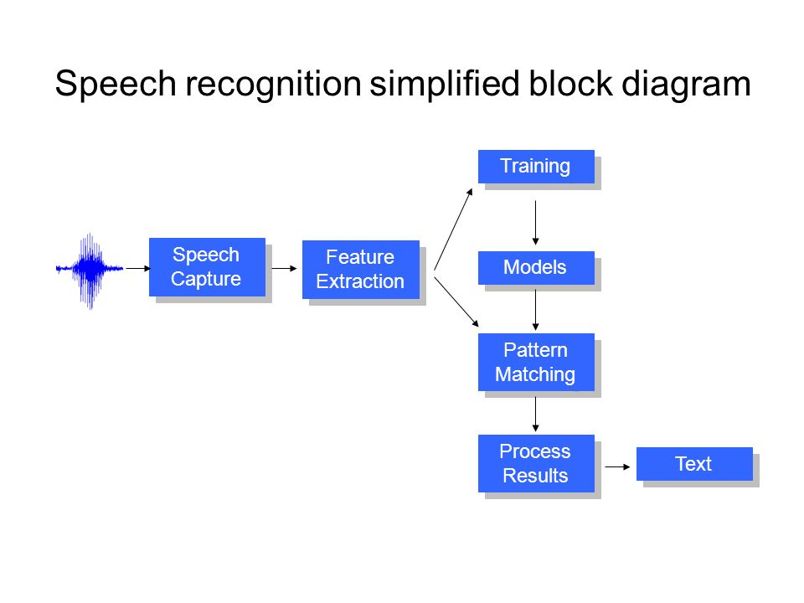
Voice Enabled Elevator

Slide 35
Can Computers Talk?
This is known as “speech synthesis”
translate text to phonetic form
e.g., “fictitious” -> fik-tish-es
use pronunciation rules to map phonemes to actual sound
e.g., “tish” -> sequence of basic audio sounds
Difficulties
sounds made by this “lookup” approach sound unnatural
sounds are not independent
e.g., “act” and “action”
modern systems (e.g., at AT&T) can handle this pretty well
a harder problem is emphasis, emotion, etc
humans understand what they are saying
machines don’t: so they sound unnatural
Conclusion:
NO, for complete sentences
YES, for individual words

Slide 36
Topics
LOAN Prediction
Visual Recognition
Image Recognition
Business (product marketing prediction)

Slide 37
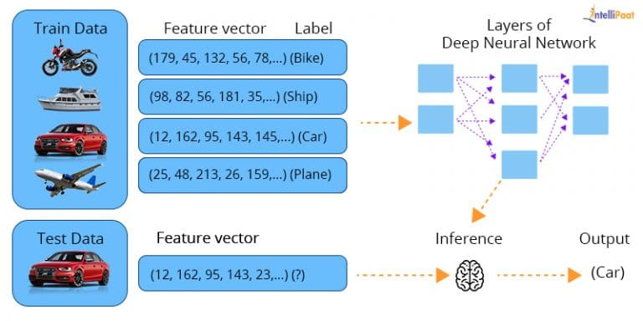

Slide 38
Can Computers “see”?
Recognition v. Understanding (like Speech)
Recognition and Understanding of Objects in a scene
look around this room
you can effortlessly recognize objects
human brain can map 2d visual image to 3d “map”
Why is visual recognition a hard problem?
Conclusion:
mostly NO: computers can only “see” certain types of objects under limited circumstances
YES for certain constrained problems (e.g., face recognition)

